Slide 1


Medical Device Classification
Faculty: Anand Malaji

Slide 2
Agenda
Medical Device Classifications

Slide 3
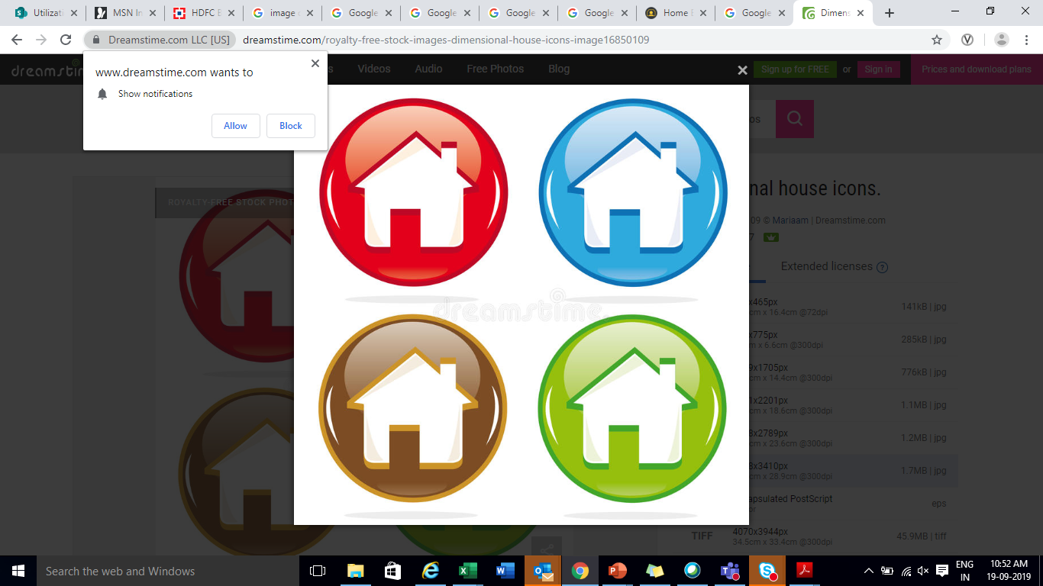
Version
Version | Reviewed by | Approved by | Remarks
1.0 | Sandeep Talya | KNS acharya | Initial Release

Slide 4
Learning Outcome of the Course
Medical Device classification (USFDA & EUMDR)
Overview of medical device classification
How to classify Medical devices
Classification examples
Notes:
<number>

Slide 5
Pre-Requites for the Course
Medical Device Requirements
Risk Management
Notes:
<number>

Slide 6
Medical Device - Classifications

Slide 7
Medical Device Classification
Medical Device classification (US FDA) :
The US Food and Drug Administration (FDA) classifies medical devices on the basis of the potential risk to the user.
Class I – Low risk,
Class II – Medium Risk,
Class III – High Risk

Slide 8
Examples of Class I, low risk devices are
- Bandages,
-Medical gloves,
-Crutches,
-Wheelchairs,
-Arm slings,
-Tongue depressors,
-Oxygen masks,
-Powered toothbrushes.

Slide 9
Examples of Class II, medium risk devices are
-Blood pressure monitors,
-Surgical needles,
-Surgical drapes,
-Surgical lasers for dermatology,
-X-ray machines,
-Nebulizers.

Slide 10
Examples of Class III, high risk devices are
- Heart pacemakers,
- Intra-aortic balloons,
- Intra-ocular lenses,
- HIV diagnostic kits,
- Cardio Vascular stents.

Slide 11
Medical Device classification
FDA classification follows the structure as below.
1. Class I devices which are “exempt” just need General Controls.
2. Class I devices, which are outside allowed “exemptions”, need General and Special Controls
3. Class II devices which are substantially equivalent to a “predicate device” need “General and Special Controls”.
4. Class II devices which do not have an equivalent predicate device” need “General and Special Controls” plus “Clinical data”.
5. Class III devices need “General and Special Controls” plus “Clinical data”.

Slide 12
Medical Device classification
Medical Device “approval requirements”.
Class I devices need to be developed and manufactured per “general controls” such as having appropriate labelling, the device labelling or branding cannot be mis-leading.
The manufacturing establishment must be registered with the FDA, effective manufacturing controls should be in-place and the
FDA need to be informed of the product to be placed onto the market.

Slide 13
Medical Device classification
Medical Device “approval requirements” – US FDA
Class II devices and Class I devices outside the allowed “exemptions” need to undergo the 510(K) clearance to market approval process. Class II devices require “special controls” which include labelling controls and post market surveillance. Class II devices should be manufactured in accordance with “good manufacturing practices”.

Slide 14
Medical Device classification
Medical Device “approval requirements”.
Class III devices will need to undergo the PMA (pre-market approval) process

Slide 15
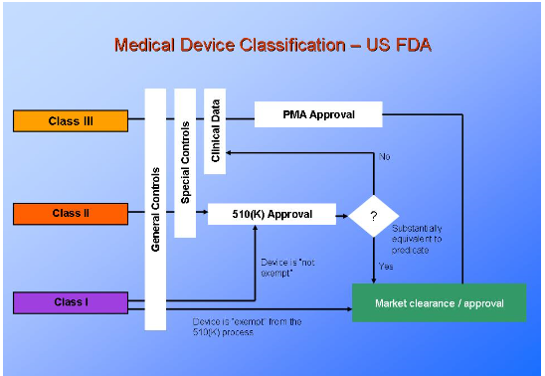
Medical Device classification
Source : http://www.presentationeze.com/presentations/medical-device-validation/medical-device-validation-full-details/validation-requirements-medical-device-design-manufacture-processing/

Slide 16
Medical Device classification
510(k) :
The 510(k) submission is the common path for medical devices to gain market clearance from FDA
The aim is to demonstrate to FDA that your product is substantially equivalent (SE) to a predicate device, a product that has been previously cleared by FDA

Slide 17
Medical Device classification
PMA: Pre Market Approval
Premarket approval (PMA) is the FDA process of scientific and regulatory review to evaluate the safety and effectiveness of Class III medical devices.
Data requirements for PMA : Two of the important requirements for PMA are
1. Non clinical Laboratory studies section
2. Clinical Investigation section

Slide 18
Medical Device classification
PMA: Pre Market Approval
Premarket approval (PMA) is the FDA process of scientific and regulatory review to evaluate the safety and effectiveness of Class III medical devices.
Data requirements for PMA : Two of the important requirements for PMA are
1. Non clinical Laboratory studies section
2. Clinical Investigation section

Slide 19
Medical Device classification
Non-clinical laboratory studies section includes information on microbiology, toxicology, immunology, biocompatibility, stress, wear, shelf life, and other laboratory or animal tests
Clinical Investigations Section: Clinical investigations section includes study protocols, safety and effectiveness data, adverse reactions and complications, device failures and replacements, patient information, patient complaints, tabulations of data from all individual subjects, results of statistical analyses, and any other information from the clinical investigations

Slide 20
Medical Device classification
US FDA - Who Classifies Devices???
The law requires a recommendation from panels based on medical specialties
The current panels are:
Anesthesiology
Cardiovascular
Clinical Chemistry and Clinical Toxicology
Dental
Ear, Nose, and Throat
Gastroenterology and Urology
General and Plastic Surgery
General Hospital and Personal Use
Hematology and Pathology
Immunology and Microbiology
Neurology
Obstetrical and Gynecological
Ophthalmic
Orthopedic
Physical Medicine
Radiology

Slide 21
Medical Device classification
The Panels
• The panel examines the device type
• The panel classifies the device as I, II, or III.
• The panel can exempt certain parts of the regulations:
– Premarket notification
– Good manufacturing practices
• When accepted, the panel’s recommendations are published as regulations

Slide 22
Medical Device classification
Classification Examples
Link:
https://www.fda.gov/MedicalDevices/DeviceRegulationandGuidance/Overview/ClassifyYourDevice/ucm051530.htm

Slide 23
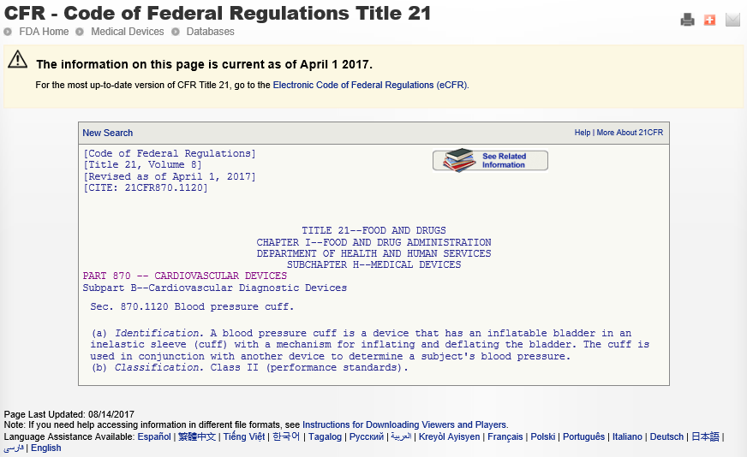
Medical Device classification – Example 1

Slide 24
Medical Device classification – Example 1
More details on classification
Link:
https://www.accessdata.fda.gov/scripts/cdrh/cfdocs/cfPCD/PCDSimpleSearch.cfm

Slide 25
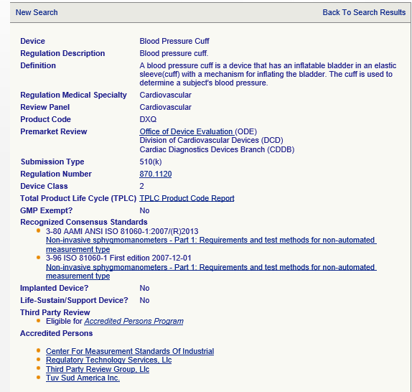
Medical Device classification – Example 1

Slide 26
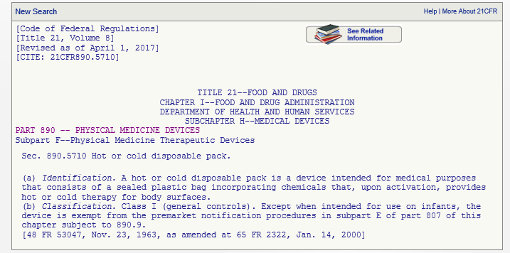
Medical Device classification – Example 2
Note: The device class remains same, but the requirements change with the intended use (adult or infant).

Slide 27
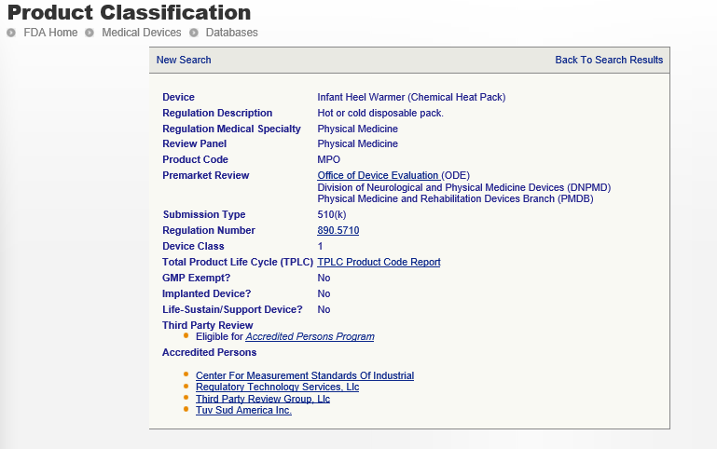
Medical Device classification – Example 2

Slide 28
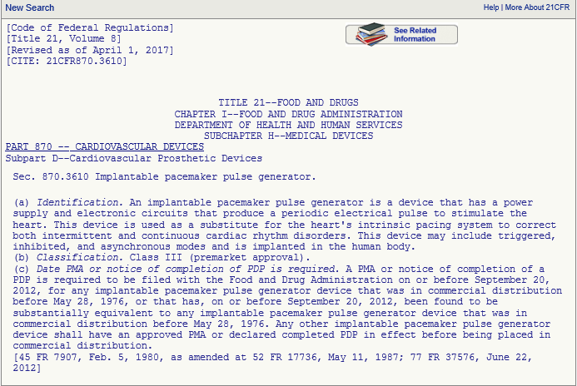
Medical Device classification – Example 3

Slide 29
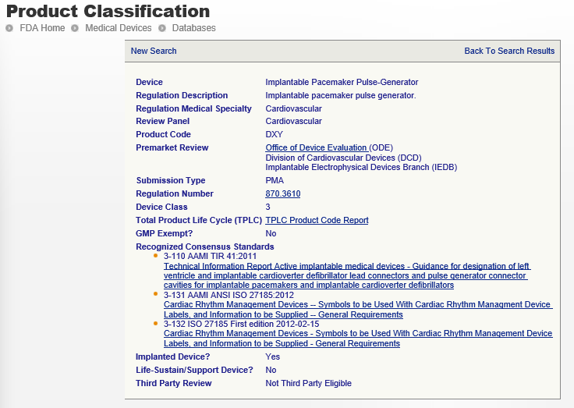
Medical Device classification – Example 3

Slide 30
Medical Device classification
Summary : for US FDA
Device classification – I, II, III
Classification determined by the FDA
Controls are based on device classification
For existing (class II) devices, Premarket notification (510K) by demonstrating substantial equivalence
For class III & new devices Premarket Approval (PMA) demonstrates the device is safe and effective.

Slide 31
Medical Device Classification
Medical Device classification
{European Union Medical Device Directive (EU MDD)} :
The EU has three directives for Medical Devices
1. Medical Device Directive (MDD) [ to be EUMDR from May 2021]
2. Active Implantable Medical Device Directive (AIMDD)
3. Invitro Diagnostic Devices (IVDD)
We will discuss only on MDD classification

Slide 32

Medical Device Classification
Medical Device Directive (93/42/EEC)
MDD
60 pages
12 Annexes
23 Articles

Slide 33
Medical Device Classification – Example 1
Blood pressure cuff
• Invasive or non-invasive: Non-invasive
– Doesn’t channel or store fluids for eventual infusion
– Doesn’t modify blood or other body fluids
– Doesn’t come into contact with injured skin
• Not an active device
• No special rules apply
• Class I by Rule 1

Slide 34
Medical Device Classification – Example 2
Infant Heel Warmer
• Invasive or non-invasive: non-invasive
– Doesn’t channel or store fluids for eventual infusion
– Doesn’t modify blood or other body fluids
– Doesn’t come into contact with injured skin
• Not an active device
• No special rules apply
• Class I by Rule 1

Slide 35
Medical Device Classification – Example 3
Coronary Stent
Invasive or non-invasive: Invasive
– Duration: Long term (Normally intended for continuous use for more than 30 days)
– Implantable (intended to be totally introduced into the body by surgery)
• Class III by Rule 8 Point 2 (An implantable device in direct contact with the central circulatory system)

Slide 36
Medical Device classification
Summary : EU MDD
Device classification – I, IIa, IIb, III
Classification is a rule based (Reference : Annex IX )
Controls are based on device classification

Slide 37
Medical Device classification
Medical Device “Approval Requirements” – European Union (EU)

Slide 38
Medical Device Classification
Medical Device classification : CANADA
Four device classes (I, II, III, or IV)
Class I represents the lowest risk and Class IV represents the highest risk
The classification rules are in SOR/98-282
Class II, III, or IV devices require a license
The required information for a license changes with the device class
The regulations are available on the Health Canada website
–http://www.hc-sc.gc.ca/dhp-mps/md-im/indexeng.php

Slide 39
DHF & Technical File
DHF : Design History File
This is the collection of documents from the design and development process.
The design history file is an FDA term described in 21 CFR Part 820.30
Per FDA, “Each manufacturer shall establish and maintain a DHF for each type of device.
Design Controls and DHF form the basis that feeds into the 510(k) and technical files (for CE marking).

Slide 40

Session Summary
Knowing how medical device is classified matters for:
Product classification will determine what you have to do before you can sell your product.
Product classification will help you establish requirements during the product development phase, specifically design controls.
Product classification is an important component in determining how much will cost to bring medical device to the market and give you some idea of how long it will take.

Slide 41

Thank You !

